Slide 1
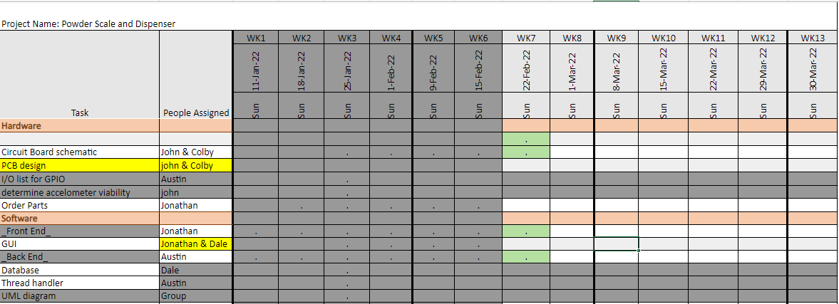
Week 6 (9-Feb to 15-Feb)

Slide 2
Week 6 (9-Feb to 15-Feb) Austin Stecklein
Goal/Task | % Done | Hours (Act.)
Finish backend events and start testing them with replacement beagle bone | 50 | 6
Finish PID and start experimenting with finding the best coefficients | 25 | 3
Start merging GUI and backend | 50 | 3
Coordinating GUI and hardware direction | NA | 2
Hours on task during the week (On track ≥ 13 / wk) | 14
Total hours on task so far this semester (On track ≥ 75 hrs) | 70

Slide 3
Progress made during the week (Log) (What I did)
Started merging backend and frontend
Testing backend on the beaglebone
Determining realistic deliverable with time frame

Slide 4
Difficulties encountered during the week (What I did not do and why)
GUI change

Slide 5
Goals for this coming week (Ones that move the project forward the most)
Goal/Task | Stop Date (Est.) | Hours (Est.)
Finish merging frontend and backend | 2/23 | 6
Get prototype working | 2/23 | 6
start documentation | 2/23 | 10
Estimated time needed to work on goals for this coming week (typ. 13 hrs) | 13

Slide 6
Week 6 (9-Feb to 15-Feb) Colby Hatton
Goal/Task | % Done | Hours (Act.)
Schematic | 90% | 4
Layout | 10% | 5
Parts/Research/Testing | 80% | 2
Hours on task during the week (On track ≥ 13 / wk) | 13
Total hours on task so far this semester (On track ≥ 75 hrs) | ~75

Slide 7
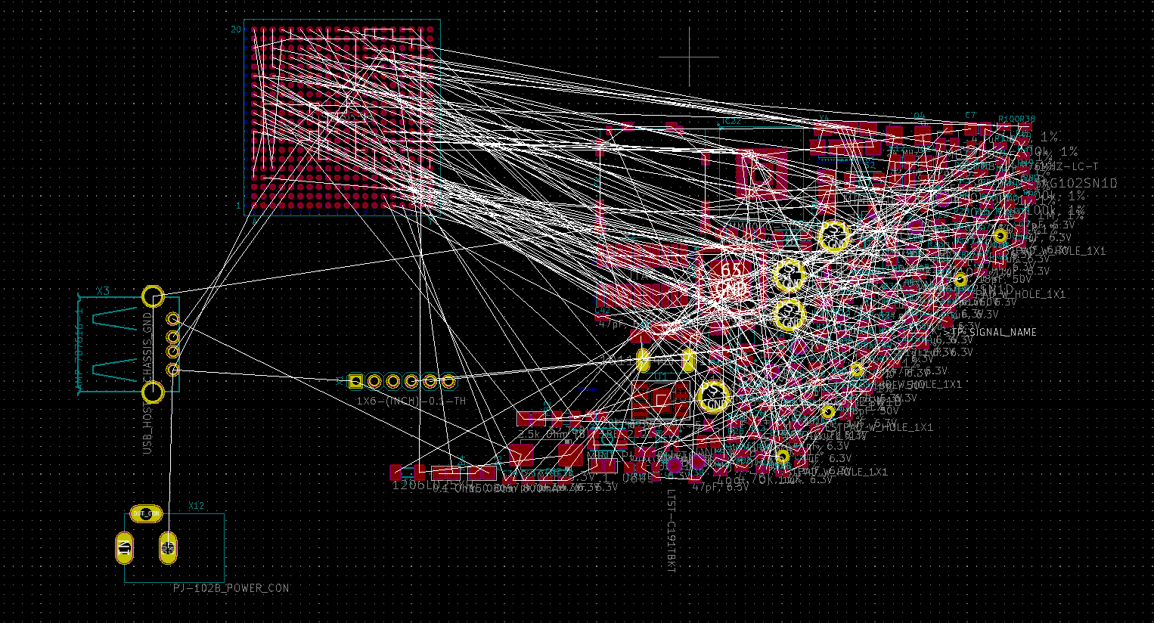
Progress made during the week (Log) (What I did)
Began board layout, imported components, defined board shape, took measurements for positioning, and cried at the rats nest that will have to be resolved.

Slide 8
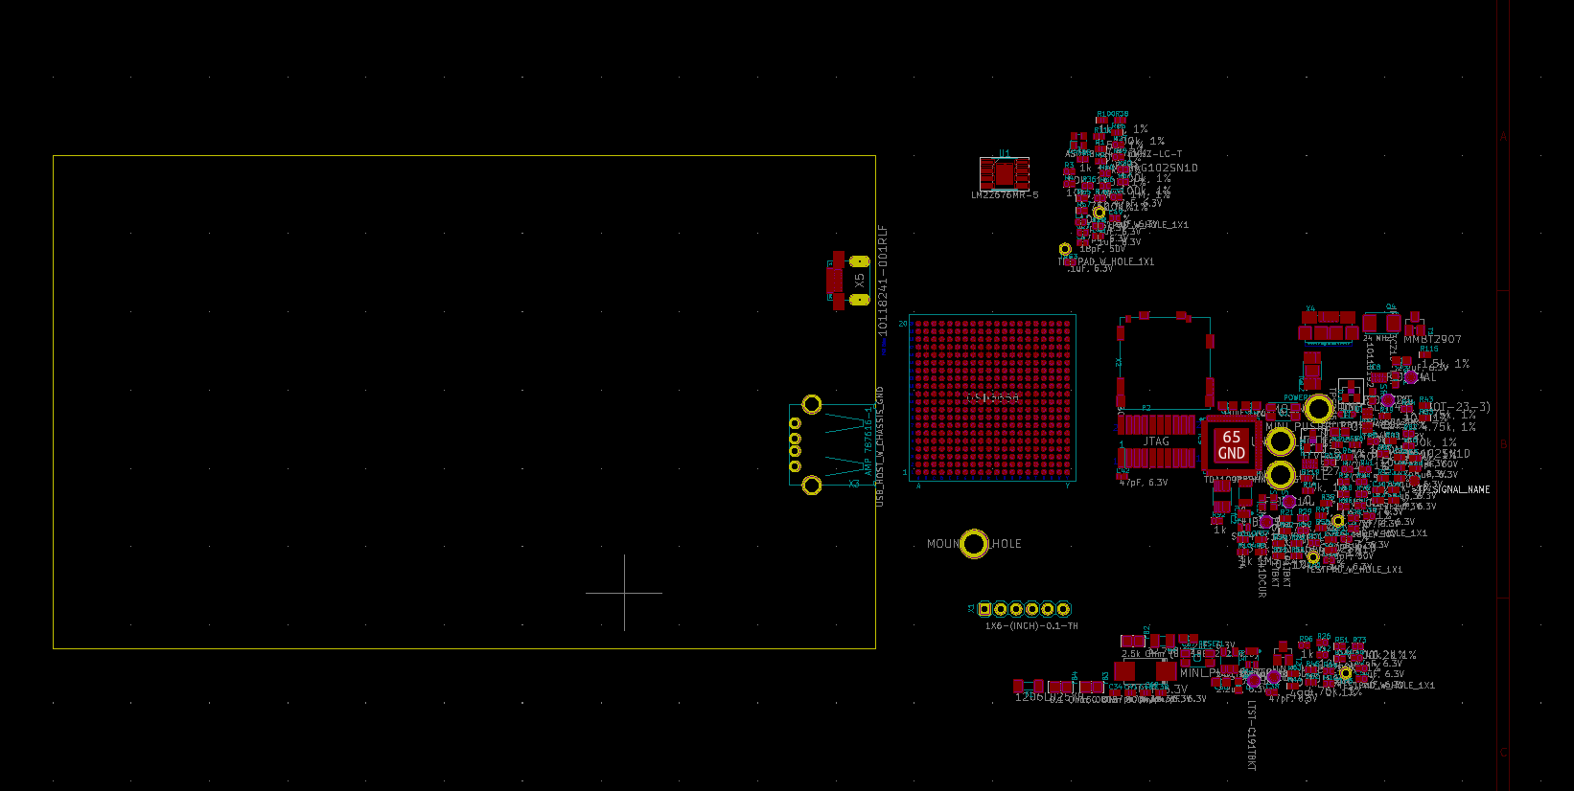

Slide 9
Difficulties encountered during the week (What I did not do and why)
Motor driver (See Johns Presentation)

Slide 10
Goals for this coming week (Ones that move the project forward the most)
Goal/Task | Stop Date (Est.) | Hours (Est.)
Continue Board Layout
Finalize Components
Estimated time needed to work on goals for this coming week (typ. 13 hrs)

Slide 11
How can we help you achieve your goals?
Be ready for questions about components/layout

Slide 12
Week 6 (9-Feb to 15-Feb) John Stinger
Goal/Task | % Done | Hours (Act.)
Driver Research |  | 5
Board Development |  | 3
Discussions and Meetings |  | 3
Hours on task during the week (On track ≥ 13 / wk) | 11
Total hours on task so far this semester (On track ≥ 75 hrs) | 62

Slide 13
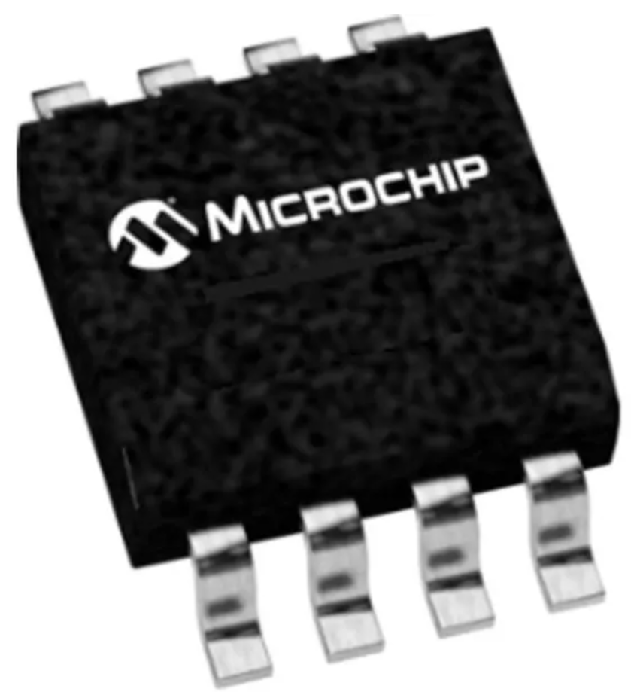
Progress made during the week (Log) (What I did)
For example: Resources found (links, manuals), Designs created, Decisions made and corresponding rational, Photos of prototype progress, etc.
The current NEMA 14 motor is rated for 4.2 V
Looking at drivers with ~ 5 – 30 V
Found open-source driver controllers

Slide 14
Difficulties encountered during the week (What I did not do and why)
Trying to determine the proper voltage

Slide 15
Goals for this coming week (Ones that move the project forward the most)
Goal/Task | Stop Date (Est.) | Hours (Est.)
Have a specific driver chip selected |  | 2
Continue with board development |  | 10
Estimated time needed to work on goals for this coming week (typ. 13 hrs)

Slide 16
How can we help you achieve your goals?
Continue to be available for questions

Slide 17
Week 5 (10-Feb to 16-Feb) Dale Andreoli
Goal/Task | % Done | Hours (Act.)
Create Load page | 75 | 2
Finish Home page |  | 4
Remake home page according to the new design | 90 | 8
Project Objective / Mission Statements
Power Scale Dispenser:
Design, build, and test the electronics for the dispenser with a touch screen display and controlling two stepper motors by April 6, 2021 with a prototyping budget of $1000 USD and for less than 600 people-hours.
Hours on task during the week | 14
Total hours on task so far this semester | 70

Slide 18
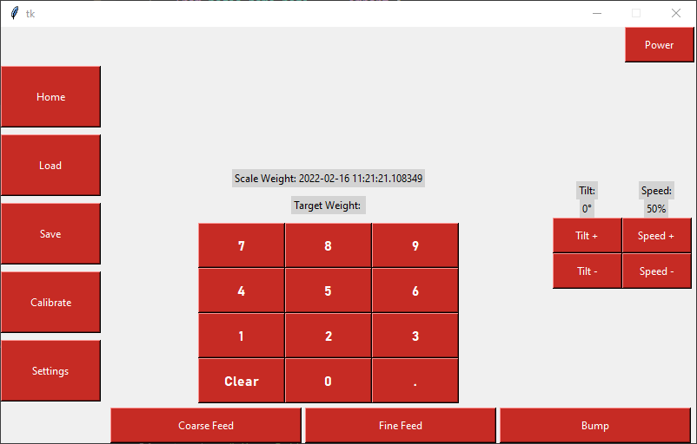
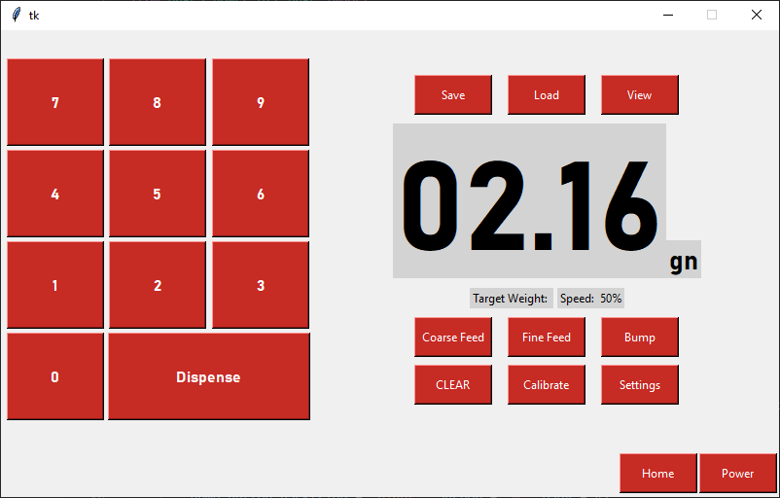
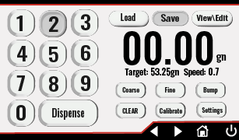
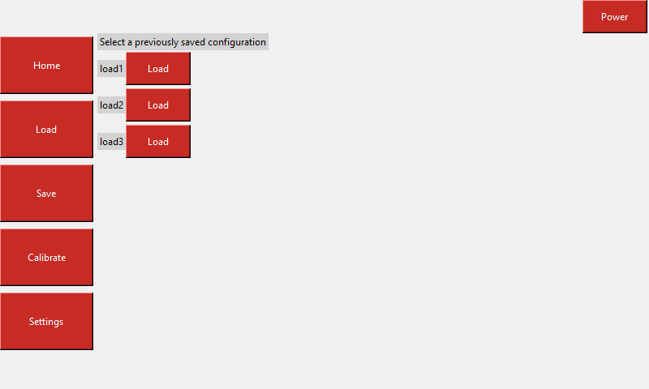
Progress made during the week (Log) (What I did)
Remade Home page according to the new design from Christian
Started Load page (old design)

Slide 19
Difficulties encountered during the week (What I did not do and why)
None

Slide 20
Goals for this coming week (Ones that move the project forward the most)
Goal/Task | Stop Date (Est.) | Hours (Est.)
Implement Load screen on the new design |  | 5
Implement Save screen |  | 5
Collaborate with Jonathan to implement buttons from the design |  | 2
Estimated time needed to work on goals for this coming week | 12

Slide 21
Week 6 (9-Feb to 15-Feb) Jonathan Phillips
Goal/Task | % Done | Hours (Act.)
Front end – How to make Images into Buttons | 100 | 2
Front end – Splicing the buttons from Christian's design | 20 | 1
Front end – General Progression |  | 10
Power Scale Dispenser:
Design, build, and test the electronics for the dispenser with a touch screen display and controlling two stepper motors by April 6, 2022, with a prototyping budget of $1000 USD and for less than 600 people-hours.
Hours on task during the week (On track ≥ 13 / wk) | 12
Total hours on task so far this semester (On track ≥ 75 hrs) | 65

Slide 22
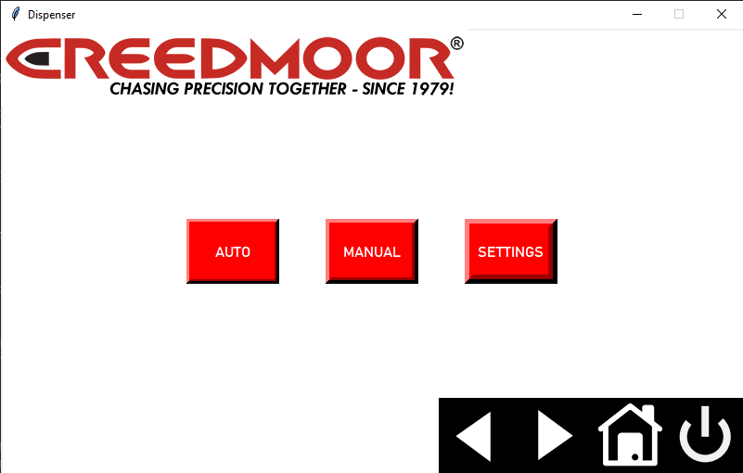
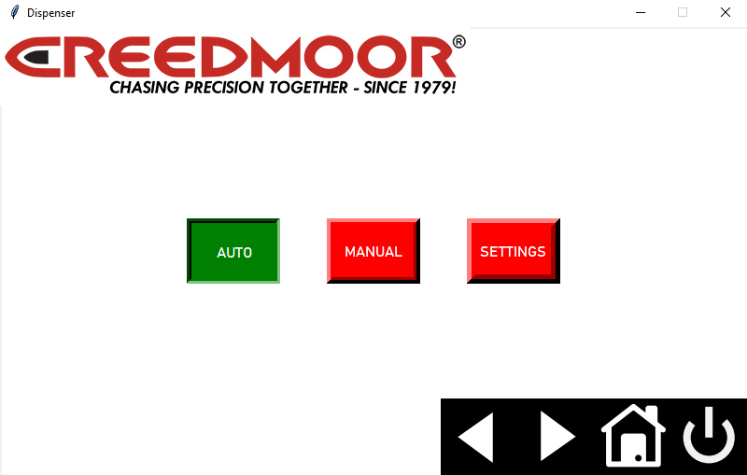

Progress made during the week (Log) (What I did)

Slide 23
Difficulties encountered during the week (What I did not do and why)
The same button cannot raise and depress itself. It can do either or, but not both.

Slide 24
Goals for this coming week (Ones that move the project forward the most)
Goal/Task | Stop Date (Est.) | Hours (Est.)
Front end – Splicing Images from Christian's design | 2/23/22 | 2
Front end – Implementation of images as buttons | 2/23/22 | 5
Front end – General Progression | 4/1/22 | 6
Estimated time needed to work on goals for this coming week (typ. 13 hrs) | 13

